Slide 1

House Price Prediction
Birla Vishvakarma Mahavidyalaya Engineering College
Information Technology Department
Group No. :- 13
Kalp Gohil 18IT405
Param Shah 18IT413
Man Desai 18IT404
Jay Patel 17IT419

Slide 2
Objective of the House Price Prediction
The goal is to predict the price of a given house according to the market prices taking into account different “features”.
Main objective in this project is to obtain reasonably good to predict house prices based on some variables included in the dataset.

Slide 3

Aim of Our Project
We will analyze data collected.
According to that we will clean and pre-process the data.
And then we will train model on this cleaned data.

Slide 4
Modules
Data Collection.
Data Pre-Processing.
Data Cleaning.
Dealing with NULL values.
Add new columns.
Register / Login.
Model Training
Designing for website.

Slide 5
Description of Modules
Data Pre-Processing :-
After having dataset in hands, its important to pre-process that raw data into useful form.
Data Cleaning :-
In this module we had cleaned our dataset if it gas any null values using following techniques..
Drop that null data.
Fill that null data with some meaning full statistical value.

Slide 6
Description of Modules
Data Transformation.
After data cleaning, we had transformed our data in appropriate form to remove outliers.
Attribute Selection :-
In this strategy we had add some new columns to our data set from existing ones to have look inside from data.

Slide 7
Description of Modules
Register / Login.
In this module we had designed one simple website.
We had added static home page.
We had also added Signup / Login page just to insure that only registered user can accesses our website.

Slide 8
Description of Modules
Model Training.
In this module we will train our data using Linear Regression.
Designing some html pages for website.
In this module we need to design html page that will take input from user (parameters of the house).
Then we need to attach our trained model to this website.

Slide 9
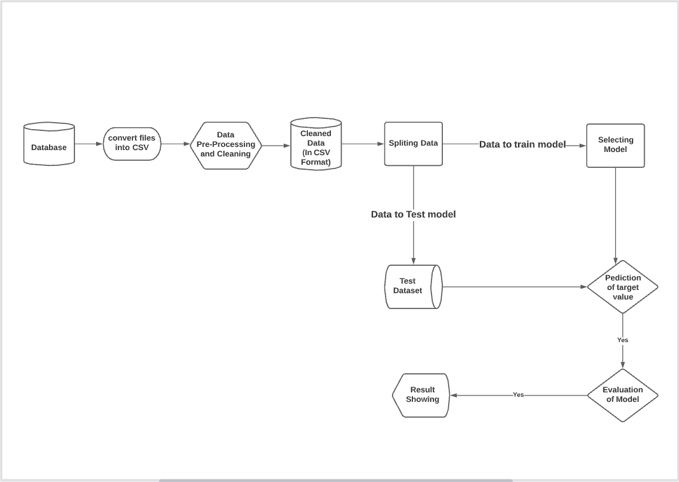
Flow of Model Training

Slide 10
Thank You…!!

